Slide 1
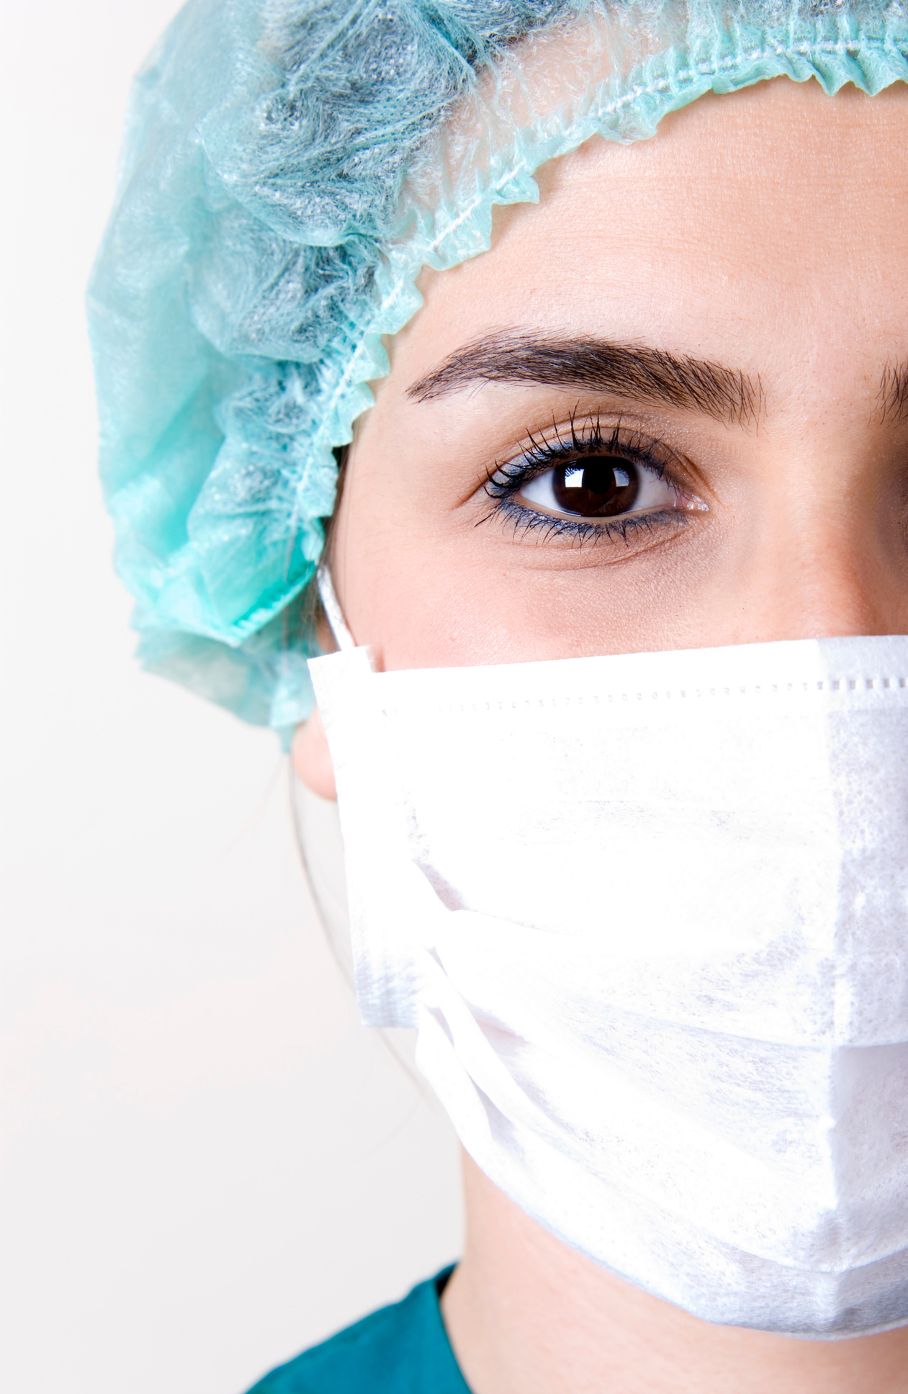
DECODING
DIABETES
Unconventional Indicators for Diabetic Diagnosis
R24 -120

Slide 2
This is our team
Supervisor - Mrs. Wishalya Tissera
Co-Supervisor - Ms. Karthiga Rajendran
Student Name | Registration Number
Sangavi G | IT21069772
Venuganth A | IT21102646
Kajanan T | IT21085062
Methiny S | IT21083228

Slide 3




01
02
03
Background
Introduction
Research Problem
CONTENTS
04
05
06
Objectives
Overall System Diagram
Research Gap
07
08
Research Question
Commercialization

Slide 4
BACKGROUND
What is Decoding Diabetes ?
Why are we focusing on this topic ?
What are the main problems we identified ?

Slide 5


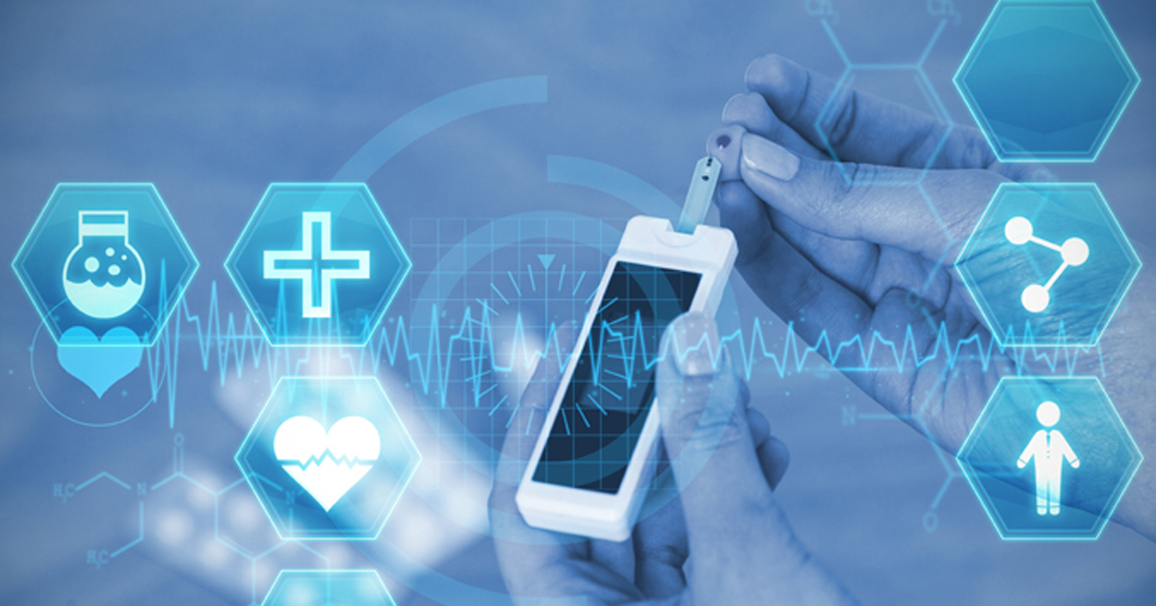
Logo Here
Introduction
Decoding Diabetes" is a user-friendly app for at-home diabetes risk assessment. It uses machine learning and image processing to analyze neck circumference, foot ulcers, infected nails, and retinopathy images.
Enables easy diabetes risk assessment from home.
Identifies potential risks through diverse indicators.
Simple interface for accessibility to all users.
Prompts early awareness, contributing to better healthcare outcomes.

Slide 6

Research problem
Addressing the challenge of accurate diabetes prediction.
This research aims to develop a reliable machine learning model.
The research problem involves achieving precision in predicting diabetes risk based on diverse indicators, fostering detection and proactive management.

Slide 7


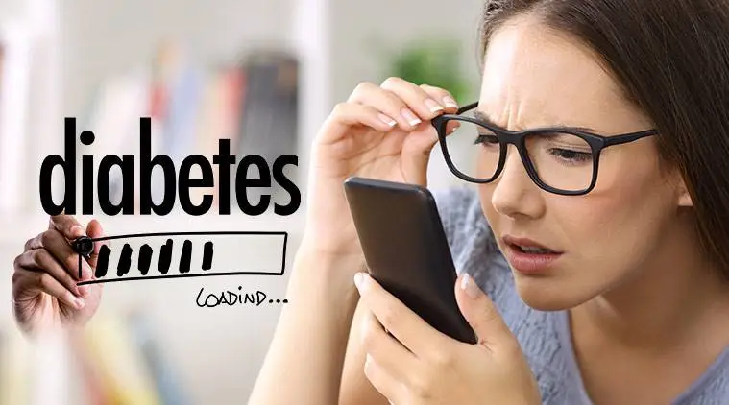
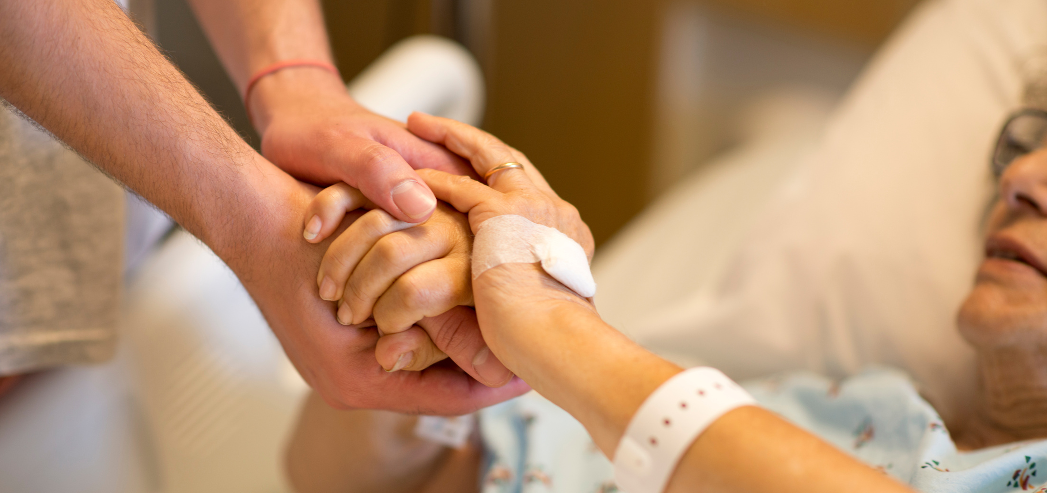
Objectives
Main Objective :
Specific Objectives
To create "Decoding Diabetes”, an advanced mobile app utilizing machine learning and image processing for convenient and accurate home-based diabetes risk assessment.
To develop machine learning algorithms for diverse image analysis.
To integrate image processing techniques for comprehensive diabetes risk prediction.
To ensure a user-friendly interface for widespread accessibility.
To promote early awareness and proactive management of diabetes.

Slide 8
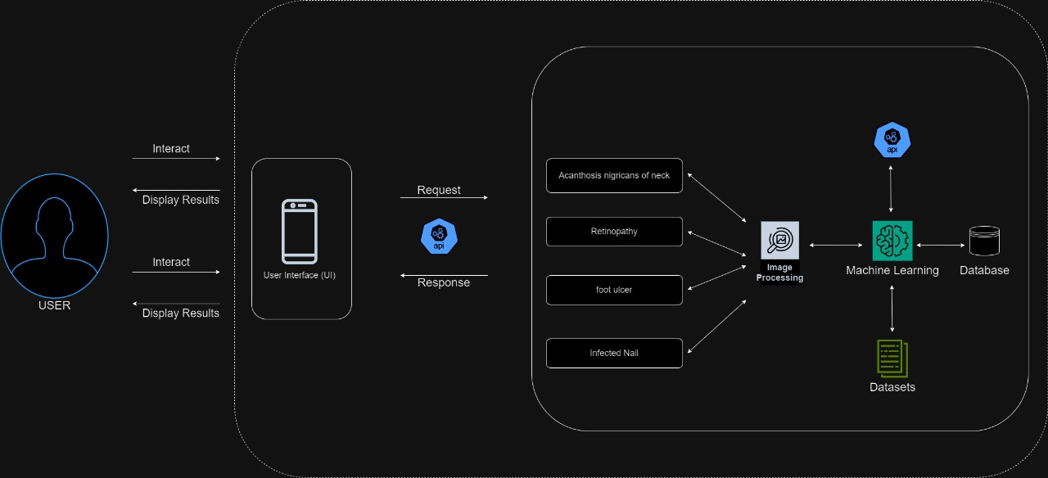
System Diagram
04

Slide 9
Research Gap
Limited Home-Based Solutions : Absence of accessible home-based diabetes diagnostic tools for the general user population.
Lack of Diverse Indicators : Current methods overlook unconventional indicators like neck circumference images, foot ulcers, infected nails, and retinal images in diabetes prediction.
User-Friendly Gap : Existing tools often lack a user-friendly interface, hindering widespread adoption among diverse users.
Delayed Detection : The absence of early, comprehensive screening tools contributes to delayed diabetes detection, limiting opportunities for proactive management
04

Slide 10


Research Question
How can machine learning algorithms be effectively employed to analyze diverse bodily features, including neck curve images, foot ulcers, infected nails, and retinopathy, for accurate and early diabetes risk prediction?
What are the key design considerations in developing a user-friendly mobile application for home-based diabetes risk assessment, ensuring accessibility and acceptance among a diverse user population?

Slide 11
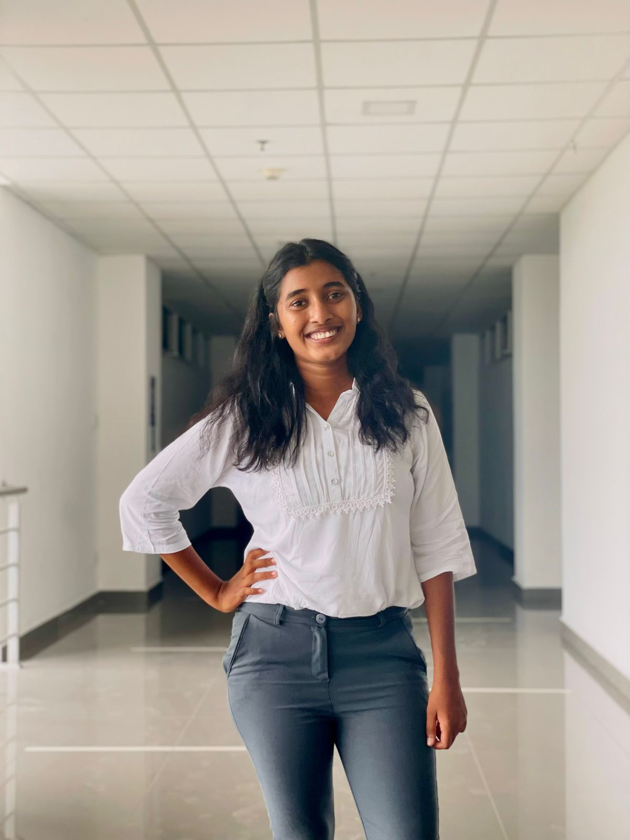
IT21069772 | Sangavi G
Diabetes Detection with Home-Captured Neck Images
BSc (Hons) in Information Technology Specialising in IT
IT21069772 | Sangavi G| TMP-24-120

Slide 12
Introduction
Our project presents a ground-breaking approach to diabetic screening
Innovative Method: Utilizes neck circumference images and machine learning for screening.
Eliminating Invasiveness: Moves away from traditional invasive blood tests and specialized equipment.
User-Friendly Solution: Offers a non-invasive, easy-to-use solution for predicting diabetes likelihood.
Symptom Detection: Facilitates early intervention by identifying individuals at risk sooner.
Global Impact: Aims to revolutionize diabetic care, potentially improving health outcomes worldwide.
IT21069772 | Sangavi G| TMP-24-120

Slide 13

Research problem
Limited accessibility and convenience of traditional blood tests.
Low public awareness and understanding of diabetes symptoms.
Lack of a non-invasive, home-based screening method for diabetes.
IT21069772 | Sangavi G| TMP-24-120

Slide 14
Research Question
Can neck circumference measurements obtained from images captured at home reliably identify individuals with signs of diabetes?
What type of machine learning model is most effective for accurate diabetes detection from neck circumference images?
What features extracted from the images are most predictive of diabetes risk?
How can the system be optimized for accuracy, usability, and user acceptance?
IT21069772 | Sangavi G| TMP-24-120

Slide 15

Research Gap
Develop a system that analyzes neck circumference images captured at home with a smartphone camera.
This could enable non-invasive, detection of diabetes.
This research would address these gaps by:
Testing if home-based neck images predict diabetes.
Finding key features in the images linked to diabetes risk.
Developing and optimizing a machine learning model for accuracy.
Studying user acceptance and ethical considerations.
Potential impact:
Make diabetes detection easier and more accessible.
Empower individuals to monitor their health at home.
Improve public awareness of diabetes and early detection
IT21069772 | Sangavi G| TMP-24-120

Slide 16


Comparative Analysis
 | Research Paper A (Doi:10.1001/jamanetworkopen.2018.3896) | Research Paper B (Doi:10.1001/archdermatol.2007.27) | Research Paper C (DOI: 10.4103/cdrp.cdrp_14_23) | Proposed System
Global Prevalence of Diabetes
Historical Perspective
Acanthosis nigricans of neck images
Telemedicine Standards
Definition and Prevalence of Diabetics by Acanthosis nigricans of neck
IT21069772 | Sangavi G| TMP-24-120

Slide 17

Objectives
Main Objective
Specific Objectives
Feasibility and Accuracy Assessment: Assess reliability of neck circumference from images for early diabetes detection.
Machine Learning Model Development: Develop algorithms for precise diabetes risk prediction using neck image features.
Mobile Application Development: Design user-friendly app for neck image capture, ML analysis, and diabetes risk feedback.
Usability and Feasibility Evaluation: Evaluate system usability across diverse populations.
Diabetes Detection with Home-Captured Neck Images
This project aims to develop and evaluate a non-invasive, home-based system for diabetes detection using images of the user's neck captured with a smartphone camera.
IT21069772 | Sangavi G| TMP-24-120

Slide 18

Requirements
Functional
Non-Functional
Use of CNN functions to deduct the diabetic symptoms by using the Acanthosis nigricans images
Well designed ui ux essential to manage the system
Flexible data connection required to generate new feature and solver user requirements
Accuracy
Usability
Accessibility
Performance
IT21069772 | Sangavi G| TMP-24-120

Slide 19
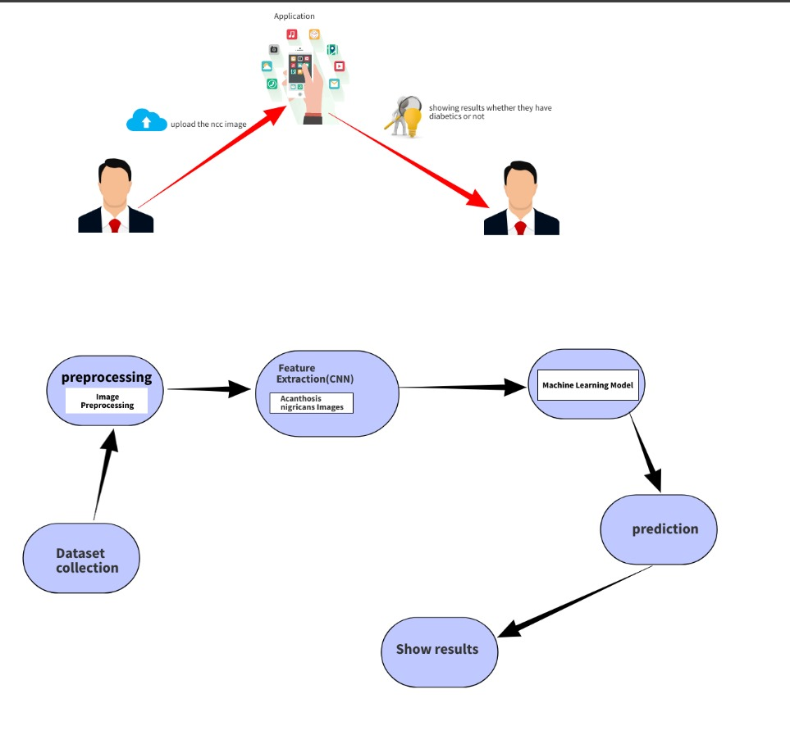
System Diagram
IT21069772 | Sangavi G| TMP-24-120

Slide 20
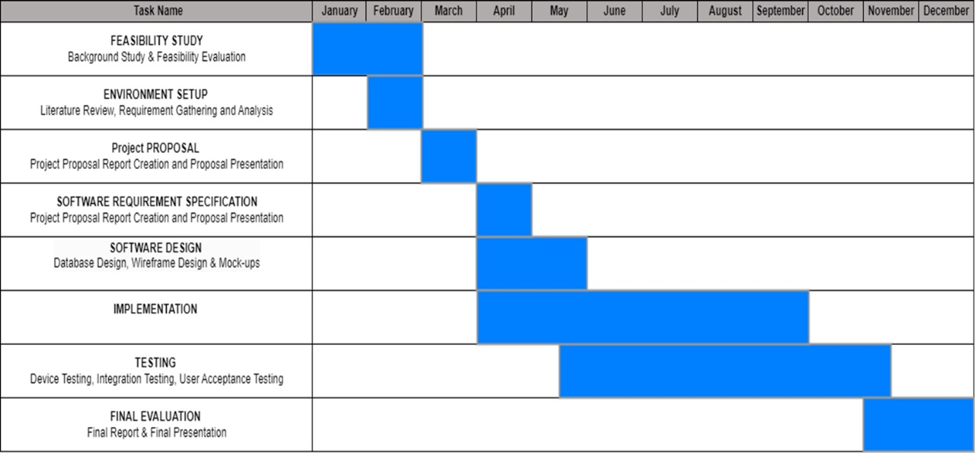
Gantt Chart
IT21069772 | Sangavi G| TMP-24-120

Slide 21
References
Lakhani, O. J. (2024). Artificial Intelligence in diabetes management and research. Chronicle of Diabetes Research and Practice, 3(1), 5–7. https://doi.org/10.4103/cdrp.cdrp_14_23
Novotny, R., Davis, J., Butel, J., Boushey, C. J., Fialkowski, M. K., Nigg, C. R., Braun, K. L., Leon Guerrero, R. T., Coleman, P., Bersamin, A., Areta, A. A., Barber, L. R., Belyeu-Camacho, T., Greenberg, J., Fleming, T., Dela Cruz-Talbert, E., Yamanaka, A., & Wilkens, L. R. (2018). Effect of the children’s healthy living program on young child overweight, obesity, and acanthosis nigricans in the US-affiliated Pacific Region. JAMA Network Open, 1(6). https://doi.org/10.1001/jamanetworkopen.2018.3896
References and reviews. (1965). JAMA: The Journal of the American Medical Association, 192(4), 148. https://doi.org/10.1001/jama.1965.03080170092046
Jeong, M., Sohn, J., Sung, M., & Kang, J. (2024). Improving Medical Reasoning through Retrieval and Self-Reflection with Retrieval-Augmented Large Language Models. arXiv preprint arXiv:2401.15269.
IT21069772 | Sangavi G| TMP-24-120

Slide 22

IT2105062 | Kajanan T
Diabetic prediction using foot ulcer
BSc (Hons) in Information Technology Specialising in IT
IT2105062 | Kajanan T | TMP-24-120

Slide 23

images.png
Introduction
This component focuses on leveraging wound analysis on foot for diabetes prediction. By assessing the stages of wounds and aim to provide detection and personalized care for individuals at risk of diabetes.
Compile labelled dataset of diabetic wounds
Apply pre-processing and feature extraction for data enhancement
Utilize a hybrid model for predictive analysis and categorization of wound stages
IT2105062 | Kajanan T | TMP-24-120

Slide 24

Research problem
Addressing the deficiency in diabetes prediction models, this study aims to develop a comprehensive approach focusing on foot wound analysis.
The research problem involves creating an effective model for accurately predicting diabetes and determining the severity stages of associated wounds.
IT2105062 | Kajanan T | TMP-24-120

Slide 25
Research Question
How can machine learning algorithms be optimized for accurate foot wound analysis in predicting diabetes and categorizing severity stages?
What design considerations are crucial in developing a user-friendly model for effective diabetes prediction through foot wound analysis, promoting accessibility and reliability?
IT2105062 | Kajanan T | TMP-24-120

Slide 26

Research Gap
Right now, there are not good models that accurately predict diabetes using foot wounds.
To need better tools, especially for figuring out how severe the wounds are and what personalized treatments might work.
IT2105062 | Kajanan T | TMP-24-120

Slide 27
Comparative Analysis
 | Research Paper A (DOI: https://doi.org/10.1186/s12938-024-01210-6) | Research Paper B (Doi:https://doi.org/10.1007/s11042-024-18304-x) | Research Paper C (DOI: https://doi.org/10.1089/wound.2023.0194) | Proposed System
Global Prevalence of Diabetes
Historical Perspective
Images of foot ulcer
Telemedicine Standards
Definition and Prevalence of Diabetics by foot ulcer
IT2105062 | Kajanan T | TMP-24-120

Slide 28
Objectives
Main Objective
Specific Objectives
Optimize machine learning algorithms for accurate foot wound analysis.
Implement a user-friendly interface for accessibility.
Categorize foot wounds into severity stages for better risk assessment.
Conduct rigorous testing to validate the model's accuracy and reliability.
Develop a precise model for diabetes prediction through foot wound analysis, enhancing early detection and tailoring interventions for effective personalized care.
IT2105062 | Kajanan T | TMP-24-120

Slide 29
Requirements
Functional
Non-Functional
Collect the data from Jaffna general hospital and taggle
Detect foot ulcer images and identify the diabetic risk
Notify the stage of the diabetics
Accuracy
Usability
Accessibility
Performance

Slide 30
Work Breakdown Chart
Diabetic prediction using foot ulcer
Project Initialization
Project Planning
Complete Data Collection
Design
Implementation
Testing
Results Documentation and Presenting
Problem Identification
Requirement Analysis
Project Component Design
Character level accuracy testing
Progress Presentations
Image detection
Domain Knowledge Gathering
Feasibility Study
Database design
Word level accuracy testing
Research Paper
Image Processing
Solution Formation
Technical Survey
Integration Testing
Final Report
Detected result
Overall System Architecture
Component System Diagram
Final Presentation
sorting
Sample Data Collection
Timeline Planning
Proposal Documentation and Presentation
IT21102646 | Venuganth A | TMP-24-120

Slide 31
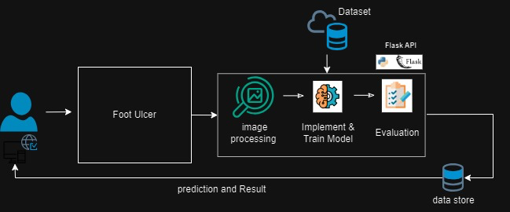
System Diagram
IT2105062 | Kajanan T | TMP-24-120

Slide 32
Gantt Chart
IT2105062 | Kajanan T | TMP-24-120

Slide 33
Reference
Piran, N., Farhadian, M., Soltanian, A.R. et al. Diabetic foot ulcers risk prediction in patients with type 2 diabetes using classifier based on associations rule mining. Sci Rep 14, 635 (2024). https://doi.org/10.1038/s41598-023-47576-w
Hettinger, G., Mitra, N., Thom, S. R., & Margolis, D. (2024). An improved clinical and genetics-based prediction model for diabetic foot ulcer healing. Advances in Wound Care. https://doi.org/10.1089/wound.2023.0194
Basiri, R., Manji, K., LeLievre, P.M. et al. Protocol for metadata and image collection at diabetic foot ulcer clinics: enabling research in wound analytics and deep learning. BioMed Eng OnLine 23, 12 (2024). https://doi.org/10.1186/s12938-024-01210-6
Fadhel, M.A., Alzubaidi, L., Gu, Y. et al. Real-time diabetic foot ulcer classification based on deep learning & parallel hardware computational tools. Multimed Tools Appl (2024). https://doi.org/10.1007/s11042-024-18304-x
IT2105062 | Kajanan T | TMP-24-120

Slide 34

IT21102646 | Venuganth A
Detect signs of retinopathy in diabetic patients' eye scans using image analysis techniques and stage prediction
BSc (Hons) in Information Technology Specialising in IT
IT21102646 | Venuganth A | TMP-24-120

Slide 35
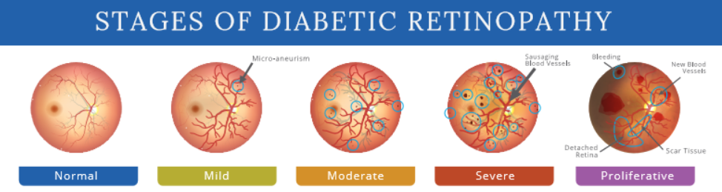
images.png
Introduction
Diabetic Retinopathy , a severe diabetes complication, early detection.
However, existing screening methods encounter hurdles.
This app introduces predictive models for diabetic retinopathy and stage identification, targeting issues like low compliance and screening quality.
IT21102646 | Venuganth A | TMP-24-120

Slide 36
Research problem
Annual retinal screenings encounter challenges with patient adherence, with reported rates ranging from 30-60%.
Existing screenings using ophthalmoscopy struggle with low quality, impacting the reliability of diabetic retinopathy examinations.
Compliance is hindered by factors such as income levels, inadequate health insurance, and time constraints.
Insufficient specialist referral systems, a shortage of eye care providers, and inadequate public health funding contribute to the challenges faced in current screenings.
IT21102646 | Venuganth A | TMP-24-120

Slide 37
Research Question
How can a comprehensive dataset be collected to facilitate the development of predictive models for diabetic retinopathy (DR) stages through a mobile app?
How effective is image analysis in detection and staging of diabetic retinopathy?
What role does patient history play in the early diagnosis and intervention of diabetic retinopathy?
How can technology improve patient engagement?
IT21102646 | Venuganth A | TMP-24-120

Slide 38
Research Gap
Long-term Effectiveness : Assessing the sustainability of the program over a more extended period and whether the benefits
Patient Outcomes and Satisfaction : Satisfaction of the patients with the process, any improvements in health outcomes, and potential barriers to participation
Quality Assurance and Accuracy: The quality of the system should be accurate to predict diabetes and the data should be reliable
IT21102646 | Venuganth A | TMP-24-120

Slide 39
Comparative Analysis
 | Research Paper A (EyePACS: An Adaptable Telemedicine System for Diabetic Retinopathy Screening) | Research Paper B (https://www.ncbi.nlm.nih.gov/pmc/articles/PMC6258577/) | Research Paper C (https://www.sciencedirect.com/science/article/pii/S2665917423002933) | Proposed System
Global Prevalence of Diabetes
Historical Perspective
Retinal Photography for DR Screening
Telemedicine Standards
Definition and Prevalence of Diabetic Retinopathy (DR)

Slide 40
Objectives
Main Objective
Specific Objectives
To provide users with a reliable tool for diagnosis of diabetes.
To identify the stage of diabetic retinopathy
To reduce the risk of vision loss associated with diabetic retinopathy
To detect signs of retinopathy in diabetic patients' eye scans using image analysis techniques and stage prediction
IT21102646 | Venuganth A | TMP-24-120

Slide 41
Requirements
Extract images from scanned images
Non-Functional Requirements
Accuracy
Speed
Scalability
Reliability
Functional Requirements
System Requirements
User Requirements
Any IOS or Android devices with 2GB of RAM, Camera, and internet connectivity.
Simple interface
Easy to operate
IT21102646 | Venuganth A | TMP-24-120

Slide 42
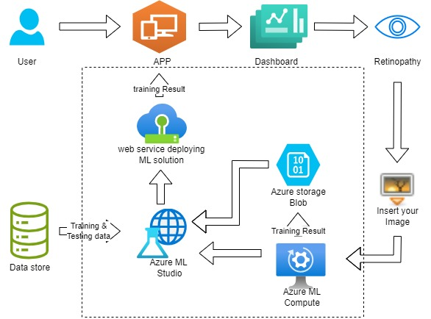
System Diagram
IT21102646 | Venuganth A | TMP-24-120

Slide 43
Work Breakdown Chart
Recognition of diabetes and identifying the stage of diabetes using Diabetic Retinopathy
Project Initialization
Project Planning
Complete Data Collection
Design
Implementation
Testing
Results Documentation and Presenting
Problem Identification
Requirement Analysis
Project Component Design
Character level accuracy testing
Progress Presentations
Image detection
Domain Knowledge Gathering
Feasibility Study
Database design
Word level accuracy testing
Research Paper
Image Processing
Solution Formation
Technical Survey
Integration Testing
Final Report
Detected result
Overall System Architecture
Component System Diagram
Final Presentation
sorting
Sample Data Collection
Timeline Planning
Proposal Documentation and Presentation
IT21102646 | Venuganth A | TMP-24-120

Slide 44
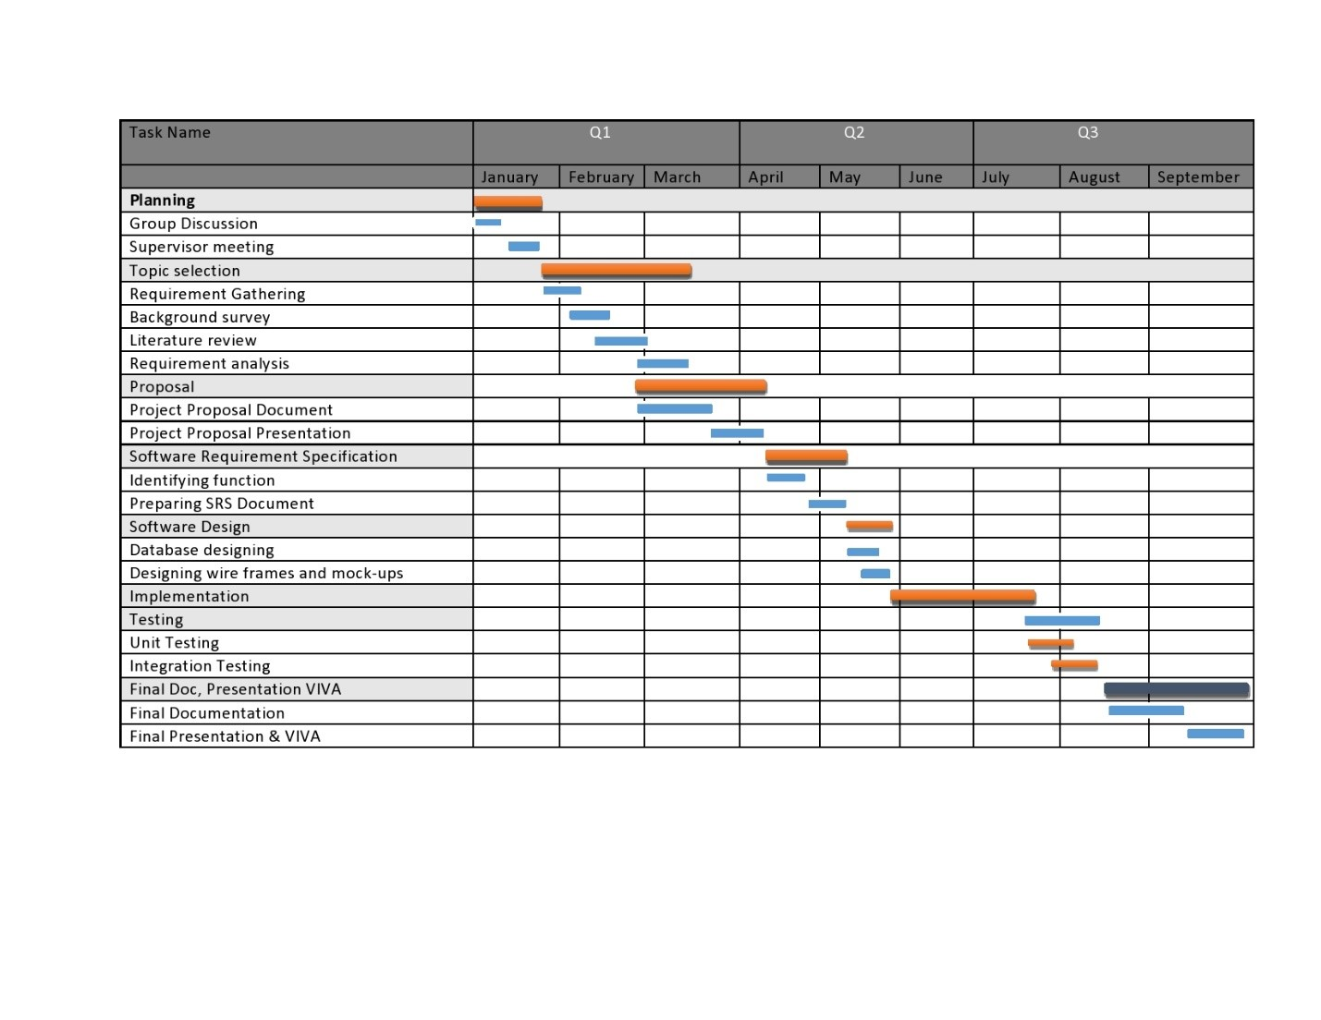
Gantt Chart
IT21102646 | Venuganth A | TMP-24-120

Slide 45
Reference
Beau J. Fenner, Raymond L. M. Wong, Wai-Ching Lam, Gavin S. W. Tan, and Gemmy C. M. Cheung corresponding author. Advances in Retinal Imaging and Applications in Diabetic Retinopathy Screening: A Review. Published online 2018 Nov 10. (https://www.ncbi.nlm.nih.gov/pmc/articles/PMC6258577/)
S. Anitha, S. Priyanka. Smart phone based automated diabetic retinopathy detection system. Published online 19 December 2023 (https://www.sciencedirect.com/science/article/pii/S2665917423002933)
Ting, D. S. W., Cheung, C. Y., Lim, G., Tan, G. S. W., Quang, N. D., Gan, A., ... & Wong, T. Y. (2017). Development and validation of a deep learning system for diabetic retinopathy and related eye diseases using retinal images from multiethnic populations with diabetes. JAMA, 318(22), 2211-2223.
Early Treatment Diabetic Retinopathy Study Research Group. Grading diabetic retinopathy from stereoscopic color fundus photographs—an extension of the Airlie House classification. ETDRS report number 10. Ophthalmology. 1991;98(5 Suppl):786–806.
Fong DS, Aiello L, Gardner TW, King GL, Blankenship G, Cavallerano JD, Ferris FL III, Klein R, American Diabetes Association. Retinopathy in diabetes. Diabetes Care. 2004;27 Suppl 1:S84–7.
Screening guidelines for diabetic retinopathy. American College of Physicians, American Diabetes Association, and American Academy of Ophthalmology. Ann Intern Med. 1992;116(8):683–5.
Wilkinson CP, Ferris FL III, Klein RE, Lee PP, Agardh CD, Davis M, Dills D, Kampik A, Pararajasegaram R, Verdaguer JT, Global Diabetic Retinopathy Project Group. Proposed international clinical diabetic retinopathy and diabetic macular edema disease severity scales. Ophthalmology. 2003:110(9):1677–82.
IT21102646 | Venuganth A | TMP-24-120

Slide 46
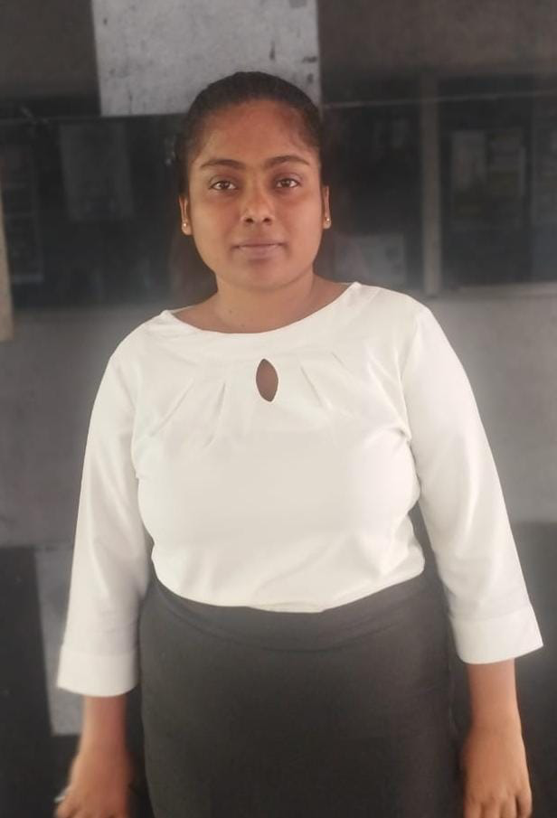
IT21083228 | Methiny S
Predicting Diabetes Through Nail Analysis
BSc (Hons) in Information Technology Specialising in IT
IT21083228| Methiny S | TMP-24-120

Slide 47
Introduction
This research focuses on employing image processing techniques on extensive datasets to predict diabetes through the analysis of infected nails. By delving into the subtle indicators present in nail images, we aim to develop an innovative model for early and accurate detection of diabetes.
IT21083228| Methiny S | TMP-24-120

Slide 48

Research problem
Many people are not familiar with the signs of diabetes, which can delay them from seeking help.
Some folks struggle to see a doctor because it's not easy to get to one or afford the costs.
There's a lot of embarrassment and fear around talking about diabetes, so people might avoid it.
Some communities don't have enough support to help prevent or manage diabetes effectively.
IT21083228| Methiny S | TMP-24-120

Slide 49
Research Question
How can image processing techniques on nail datasets be optimized for accurate and early prediction of diabetes?
What design considerations are essential in developing a user-friendly model for diabetes prediction through infected nail analysis, ensuring accessibility and reliability?
IT21083228| Methiny S | TMP-24-120

Slide 50

Research Gap
Existing methods lack robust models for diabetes prediction through nail analysis.
This research bridges the gap by introducing an innovative approach, leveraging image processing on nail datasets for more accurate and accessible early detection.
IT21083228| Methiny S | TMP-24-120

Slide 51
Comparative Analysis
 | Research Paper A (https://doi.org/10.1002/pdi.2124) | Research Paper B (https://doi.org/10.1038%2Fs41598-019-39951-3) | Research Paper C (https://doi.org/10.1002/pdi.2124) | Proposed System
Global Prevalence of Diabetes
Historical Perspective
Infected nail images
Telemedicine Standards
Definition and Prevalence of Diabetic infected nail
IT21083228| Methiny S | TMP-24-120

Slide 52
Objectives
Main Objective
Specific Objectives
Create a mobile app to detect diabetes using pictures of infected nails.
Identify nail features that suggest diabetes, like changes in color or thickness.
Test different methods and settings to ensure the program works well.
Test the program on many nail pictures to confirm its accuracy for people with and without diabetes.
Design a simple app to make the program easy to use.
Create a mobile app that can tell if someone might have diabetes by looking at pictures of their infected nails.
IT21083228| Methiny S | TMP-24-120

Slide 53
Requirements
Functional
Non-Functional
Proper data collection in general hospital of Jaffna and preprocessing
Create user experience design
Navigate the respective results page according to the infected nail image
Accuracy
Usability
Accessibility
Performance
IT21083228| Methiny S | TMP-24-120

Slide 54

System Diagram
IT21083228| Methiny S | TMP-24-120

Slide 55
Work Breakdown Chart
Predicting Diabetes Through Nail Analysis
Project Initialization
Project Planning
Complete Data Collection
Design
Implementation
Testing
Results Documentation and Presenting
Problem Identification
Requirement Analysis
Project Component Design
Character level accuracy testing
Progress Presentations
Image detection
Domain Knowledge Gathering
Feasibility Study
Database design
Word level accuracy testing
Research Paper
Image Processing
Solution Formation
Technical Survey
Integration Testing
Final Report
Detected result
Overall System Architecture
Component System Diagram
Final Presentation
sorting
Sample Data Collection
Timeline Planning
Proposal Documentation and Presentation
IT21102646 | Venuganth A | TMP-24-120

Slide 56
Gantt Chart
IT21083228| Methiny S | TMP-24-120

Slide 57
Reference
Lakhani, O. J. (2024). Artificial Intelligence in diabetes management and research. Chronicle of Diabetes Research and Practice, 3(1), 5–7. https://doi.org/10.4103/cdrp.cdrp_14_23
Macura, A. B., Gasińska, T., Pawlik, B., & Obłoza, A. (2007). Podatność paznokci na zakazenie grzybicze u chorych na cukrzyce typu 1 i 2 z długoterminowa zła kontrola glikemii [Nail susceptibility to fungal infection in patients with type 1 and 2 diabetes under long term poor glycaemia control]. Przeglad lekarski, 64(6), 406–409.
Sihota, P., Yadav, R. N., Dhiman, V., Bhadada, S. K., Mehandia, V., & Kumar, N. (2019). Investigation of diabetic patient's fingernail quality to monitor type 2 diabetes induced tissue damage. Scientific reports, 9(1), 3193. https://doi.org/10.1038/s41598-019-39951-3
Hillson, R. (2017a). Nails in diabetes. Practical Diabetes, 34(7), 230–231. https://doi.org/10.1002/pdi.2124
IT21083228| Methiny S | TMP-24-120

Slide 58



Technologies
Language : Python
Front End : Flutter
Libraries
OpenCv
Keras
TensorFlow
PyTorch

Slide 59

Commercialization
Premium Tips:
Deep-dive into target audience needs.
Set a sustainable pricing model.
Plan how to reach your target audience.
Prioritize transparency and ethical considerations.
Success depends on overcoming challenges and proving effectiveness.
Early diabetes detection with a phone pic? Exciting, but needs planning.
Value: No needles, easy to use, potentially catches diabetes early.
Market: Millions with diabetes, tired of inconvenient tests.

Slide 60
Reference
1.History of foot ulcer among persons with diabetes: United States, 2000–2002. MMWR Morb Mortal Wkly Rep 52: 1098–1102, 2003
2.Adler AI, Boyko EJ, Ahroni JH, Smith DG: Lower-extremity amputation in diabetes: the independent effects of peripheral vascular disease, sensory neuropathy, and foot ulcers. Diabetes Care 22:1029–1035, 1999
3.Pecoraro RE, Ahroni JH, Boyko EJ, Stensel VL: Chronology and determinants of tissue repair in diabetic lower-extremity ulcers. Diabetes 40:1305–1313, 1991
4.Boulton AJ, Kirsner RS, Vileikyte L: Clinical practice: neuropathic diabetic foot ulcers. N Engl J Med 351:48–55, 2004
5.Boyko EJ, Ahroni JH, Stensel V, Forsberg RC, Davignon DR, Smith DG: A prospective study of risk factors for diabetic foot ulcer: the Seattle Diabetic Foot Study. Diabetes Care 22:1036–1042, 1999

Slide 61

THANK
YOU

